Slide 1
Quantitative Risk Management Lecture 8: Extreme Value Theory
Roy E. DeMeo, Jr.

Slide 2
What is Extreme Value Theory
The Central Limit Theorem is a statement about the limiting distribution of the average of n i.i.d. random variables as n goes to infinity.
Extreme Value theory, contrast, says something about the distribution of the maximum, or extreme tail of n samples of a distribution, under certain conditions.

Slide 3
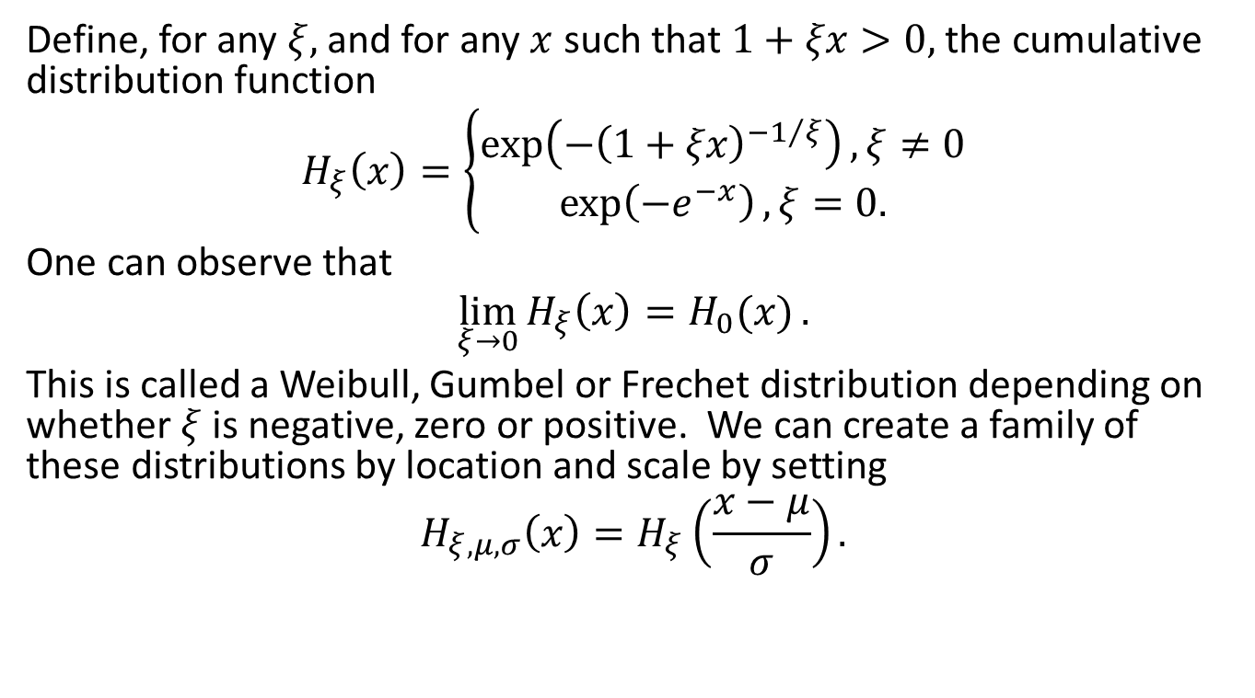
Generalized Extreme Value Distribution, or GEV
Define, for any $ξ,$ and for any $x$ such that $1+ξx>0,$ the cumulative distribution function
$$H_{ξ}\left(x\right)=\left\{\begin{aligned}\exp\left(−{\left(1+ξx\right)}^{−1/ξ}\right), ξ≠0 \\ \exp\left(−e^{−x}\right), ξ=0.\end{aligned}\right.$$
One can observe that
$$\lim_{ξ→0}{H_{ξ}\left(x\right)=H_{0}(x)}.$$
This is called a Weibull, Gumbel or Frechet distribution depending on whether $ξ$ is negative, zero or positive. We can create a family of these distributions by location and scale by setting
$$H_{ξ,μ,σ}\left(x\right)=H_{ξ}\left(\frac{x−μ}{σ}\right).$$

Slide 4
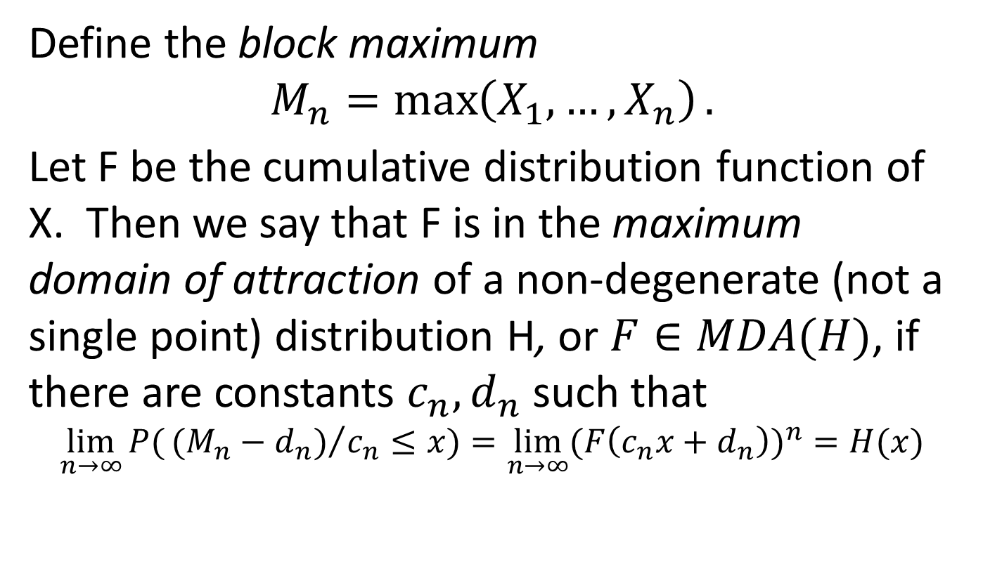
Maximum Domain of Attraction
Define the block maximum
$$M_{n}=\max\left(X_{1},…,X_{n}\right).$$
Let F be the cumulative distribution function of X. Then we say that F is in the maximum domain of attraction of a non-degenerate (not a single point) distribution H, or $F∈MDA(H)$, if there are constants $c_{n},d_{n}$ such that
$$\lim_{n→∞}{P(}{(M_{n}−d_{n})}/{c_{n}}≤x)=\lim_{n→∞}{{(F\left(c_{n}x+d_{n}\right))}^{n}}=H(x)$$

Slide 5
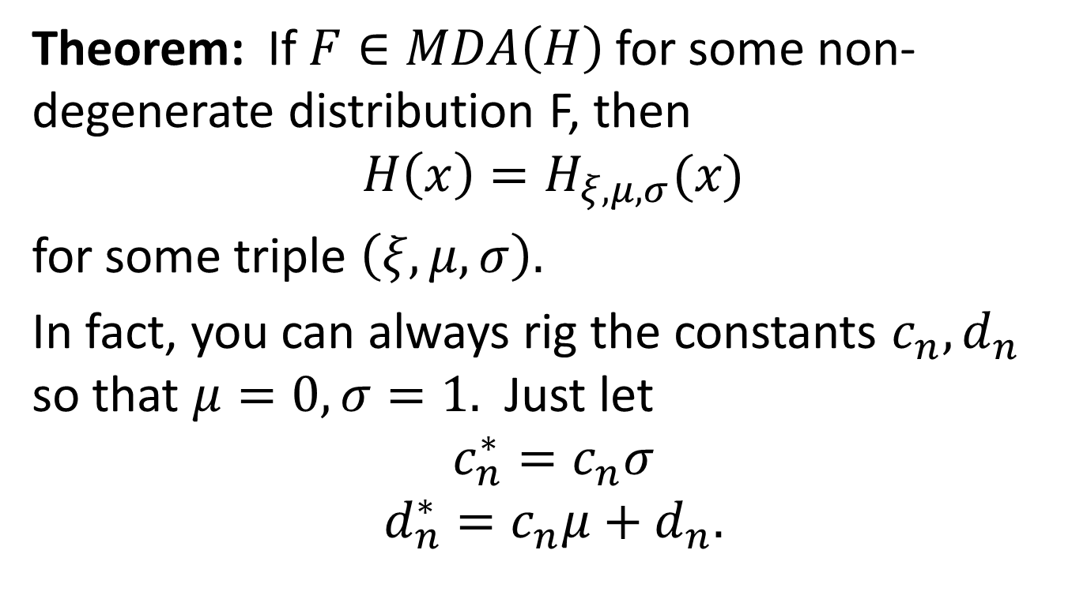
H has to be GEV
Theorem: If $F∈MDA\left(H\right)$ for some non-degenerate distribution F, then
$$H\left(x\right)=H_{ξ,μ,σ}(x)$$
for some triple $\left(ξ,μ,σ\right).$
In fact, you can always rig the constants $c_{n},d_{n}$ so that $μ=0,σ=1.$ Just let
$$c_{n}^{∗}=c_{n}σ$$
$$d_{n}^{∗}=c_{n}μ+d_{n}.$$

Slide 6
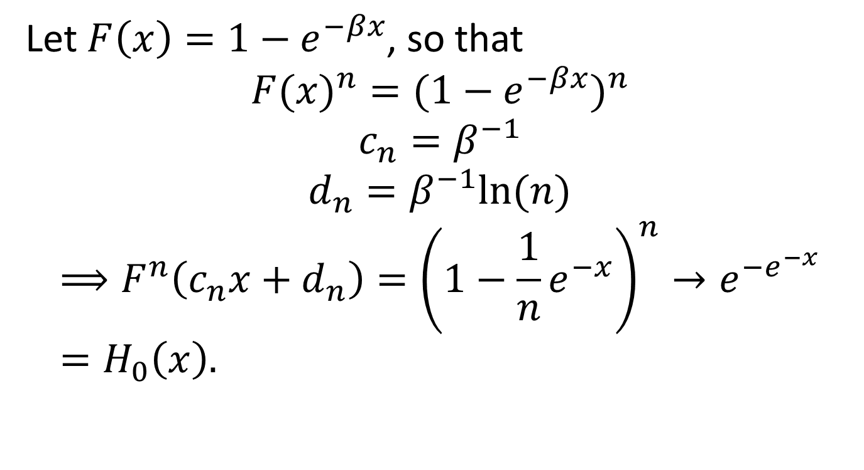
Simple Example – Exponential Distribution
Let $F\left(x\right)=1−e^{−βx}$, so that
$${F(x)}^{n}={(1−e^{−βx})}^{n}$$
$$c_{n}=β^{−1}$$
$$d_{n}=β^{−1}ln⁡(n)$$
$$⟹F^{n}\left(c_{n}x+d_{n}\right)={\left(1−\frac{1}{n}e^{−x}\right)}^{n}→e^{−e^{−x}}=H_{0}\left(x\right).$$

Slide 7
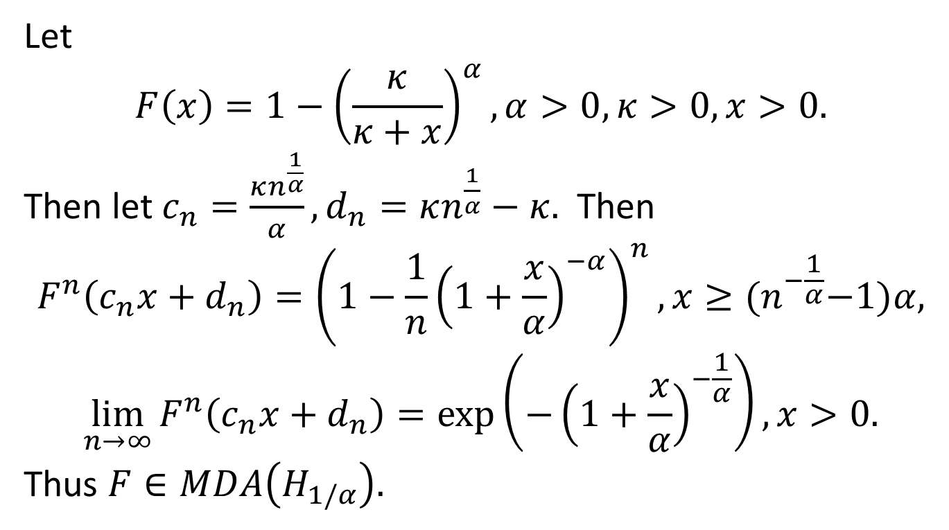
Another Example – Pareto Distribution
Let
$$F\left(x\right)=1−{\left(\frac{κ}{κ+x}\right)}^{α},α>0,κ>0,x>0.$$
Then let $c_{n}=\frac{κn^{\frac{1}{α}}}{α}, d_{n}=κn^{\frac{1}{α}}−κ.$ Then
$$F^{n}\left(c_{n}x+d_{n}\right)={\left(1−\frac{1}{n}{\left(1+\frac{x}{α}\right)}^{−α}\right)}^{n}, x≥{(n}^{−\frac{1}{α}}−1)α,$$
$$\lim_{n→∞}{F^{n}\left(c_{n}x+d_{n}\right)}=\exp\left(−{\left(1+\frac{x}{α}\right)}^{−\frac{1}{α}}\right),x>0.$$
Thus $F∈MDA\left(H_{1/α}\right).$

Slide 8
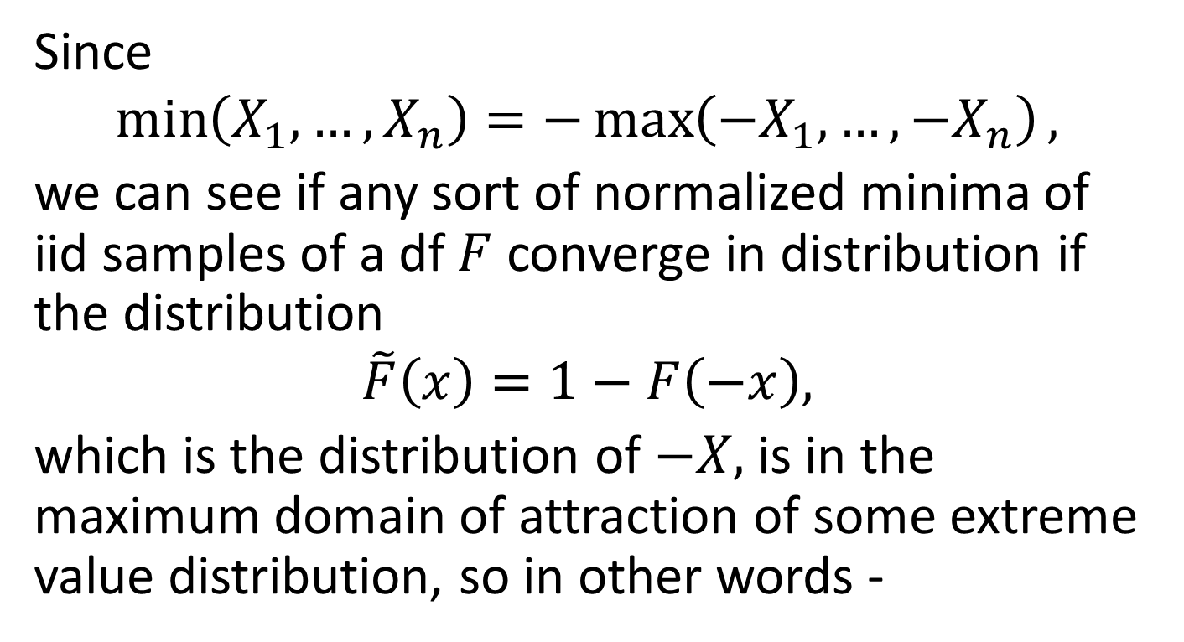
Minima vs Maxima
Since
$$\min\left(X_{1},…,X_{n}\right)=−\max\left(−X_{1},…,−X_{n}\right),$$
we can see if any sort of normalized minima of iid samples of a df $F$ converge in distribution if the distribution
$$\tilde{F}\left(x\right)=1−F\left(−x\right),$$
which is the distribution of $−X,$ is in the maximum domain of attraction of some extreme value distribution, so in other words -

Slide 9
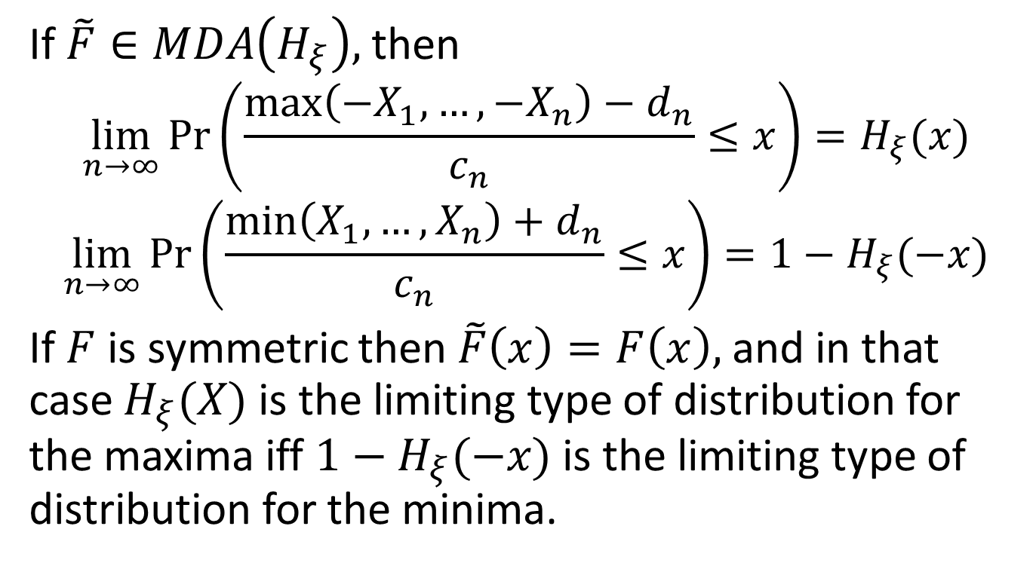
Minima vs Maxima
If $\tilde{F}∈MDA\left(H_{ξ}\right),$then
$$\lim_{n→∞}{\operatorname{Pr}\left(\frac{\max\left(−X_{1},…,−X_{n}\right)−d_{n}}{c_{n}}≤x\right)=H_{ξ}(x)}$$
$$\lim_{n→∞}{\operatorname{Pr}\left(\frac{\min\left(X_{1},…,X_{n}\right)+d_{n}}{c_{n}}≤x\right)=1−H_{ξ}(−x)}$$
If $F$ is symmetric then $\tilde{F}\left(x\right)=F\left(x\right),$ and in that case $H_{ξ}(X)$ is the limiting type of distribution for the maxima iff $1−H_{ξ}(−x)$ is the limiting type of distribution for the minima.

Slide 10
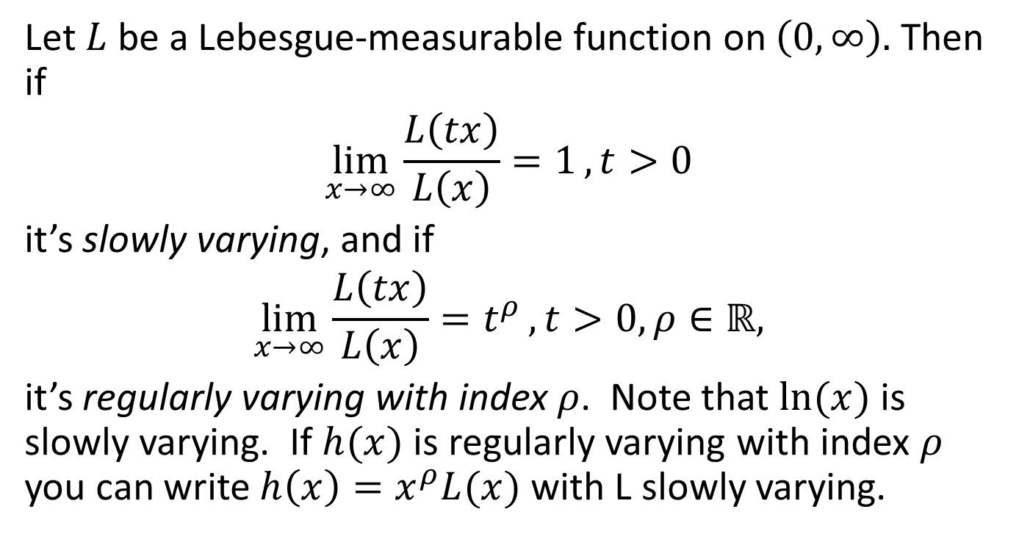
Slowly Varying and Regularly Varying Functions
Let $L$ be a Lebesgue-measurable function on $\left(0,∞\right).$ Then if
$$\lim_{x→∞}{\frac{L\left(tx\right)}{L\left(x\right)}=1},t>0$$
it’s slowly varying, and if
$$\lim_{x→∞}{\frac{L\left(tx\right)}{L\left(x\right)}=t^{ρ}}, t>0,ρ∈ℝ,$$
it’s regularly varying with index $ρ$. Note that $ln⁡(x)$ is slowly varying. If $h(x)$ is regularly varying with index $ρ$ you can write $h\left(x\right)=x^{ρ}L(x)$ with L slowly varying.

Slide 11
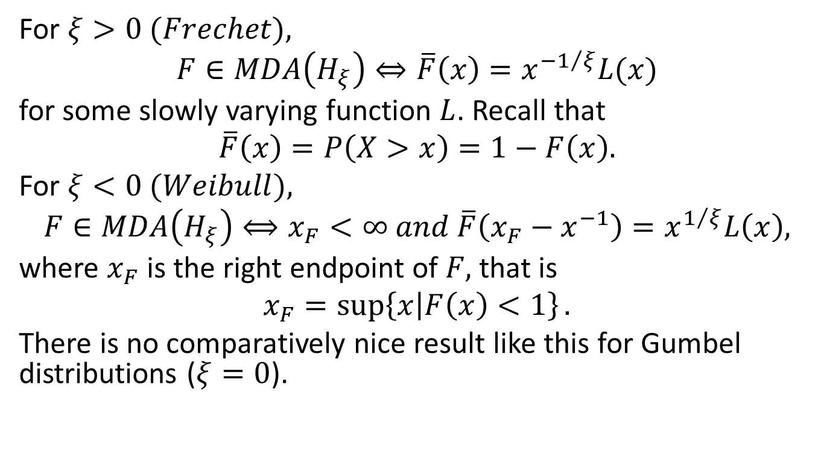
Frechet, Weibull Maximum Domains of Attraction
For $ξ>0 (Frechet),$
$$F∈MDA\left(H_{ξ}\right)⇔\overline{F}\left(x\right)=x^{−1/ξ}L(x)$$
for some slowly varying function $L$. Recall that
$$\overline{F}\left(x\right)=P\left(X>x\right)=1−F\left(x\right).$$
For $ξ<0 (Weibull),$
$$F∈MDA\left(H_{ξ}\right)⟺x_{F}<∞ and \overline{F}\left(x_{F}−x^{−1}\right)=x^{1/ξ}L\left(x\right),$$
where $x_{F}$ is the right endpoint of $F,$ that is
$$x_{F}=\sup\left\{x | F\left(x\right)<1\right\}.$$
There is no comparatively nice result like this for Gumbel distributions ($ξ=0$).

Slide 12
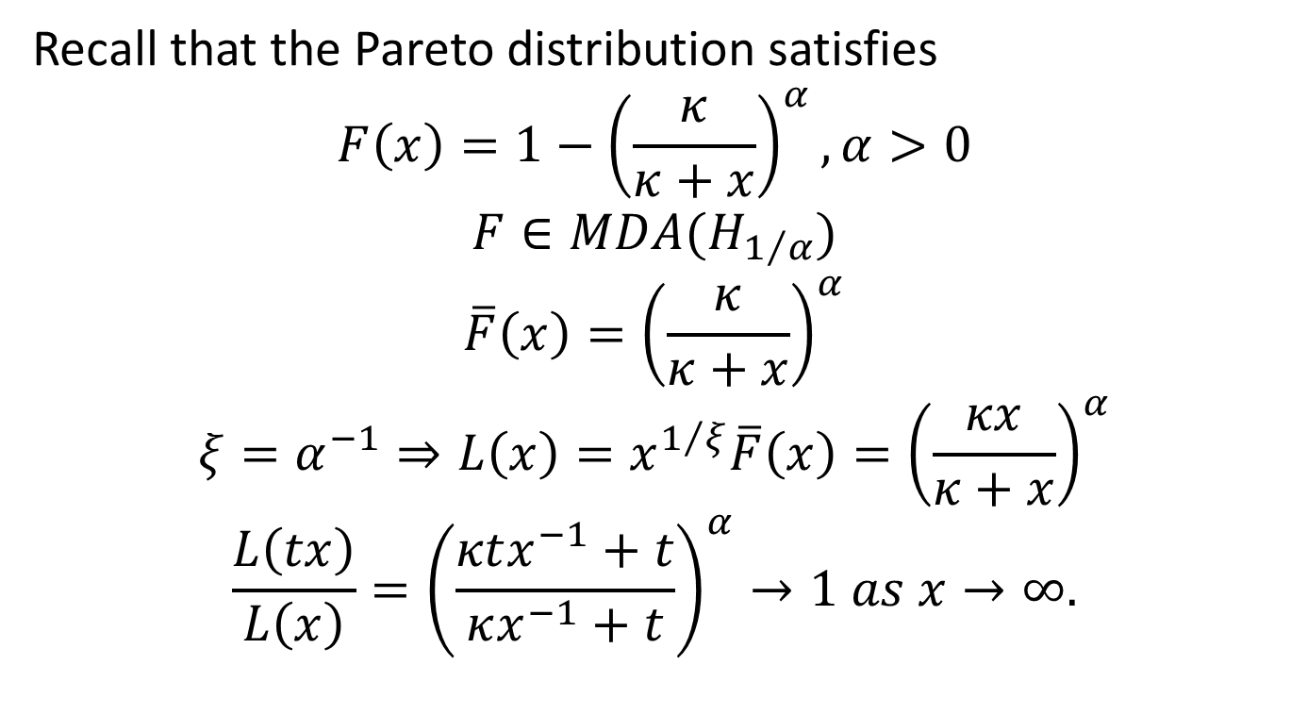
Example: Pareto Distribution
Recall that the Pareto distribution satisfies
$$F\left(x\right)=1−{\left(\frac{κ}{κ+x}\right)}^{α},α>0$$
$$F∈MDA(H_{1/α})$$
$$\overline{F}\left(x\right)={\left(\frac{κ}{κ+x}\right)}^{α}$$
$$ξ=α^{−1}⇒L\left(x\right)=x^{1/ξ}\overline{F}\left(x\right)={\left(\frac{κx}{κ+x}\right)}^{α}$$
$$\frac{L\left(tx\right)}{L\left(x\right)}={\left(\frac{κtx^{−1}+t}{κx^{−1}+t}\right)}^{α}→1 as x→∞.$$

Slide 13
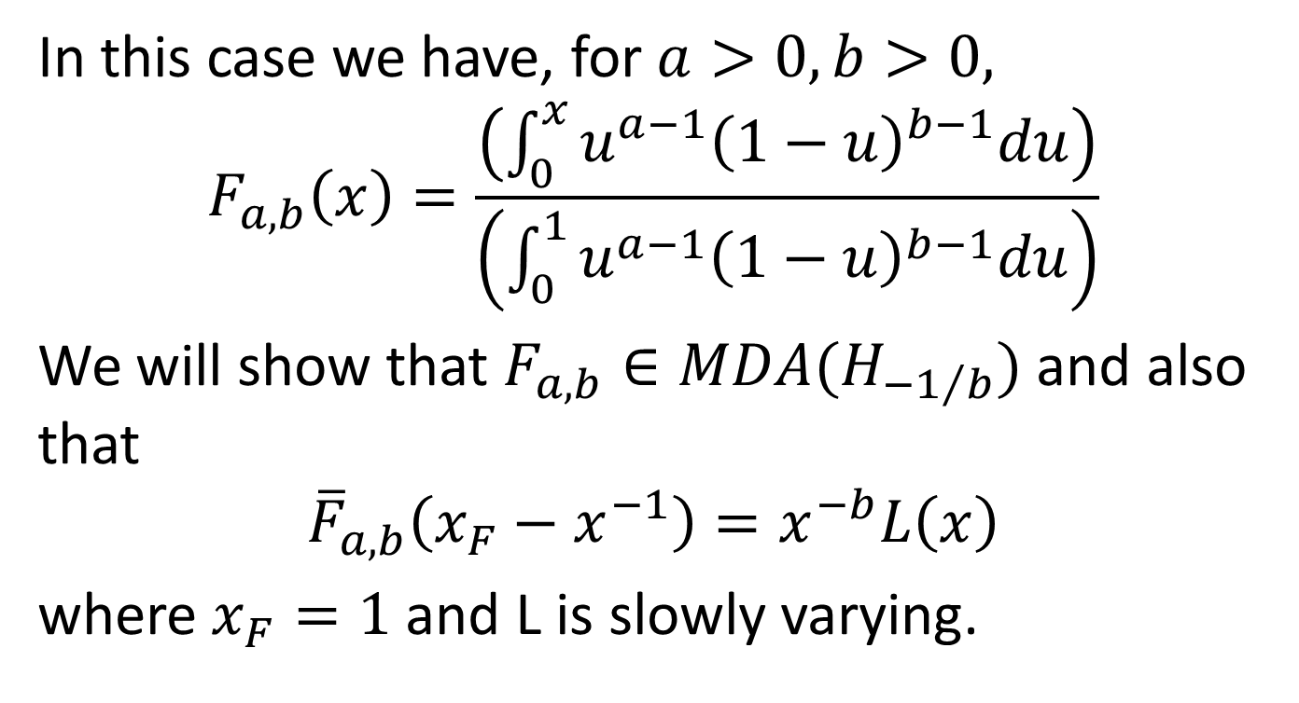
Example: Beta Distribution
In this case we have, for $a>0,b>0,$
$$F_{a,b}\left(x\right)=\frac{\left(\int_{0}^{x}{u^{a−1}{\left(1−u\right)}^{b−1}du}\right)}{\left(\int_{0}^{1}{u^{a−1}{\left(1−u\right)}^{b−1}du}\right)}$$
We will show that $F_{a,b}∈MDA(H_{−1/b})$ and also that
$${\overline{F}}_{a,b}\left(x_{F}−x^{−1}\right)=x^{−b}L\left(x\right)$$
where $x_{F}=1$ and L is slowly varying.

Slide 14
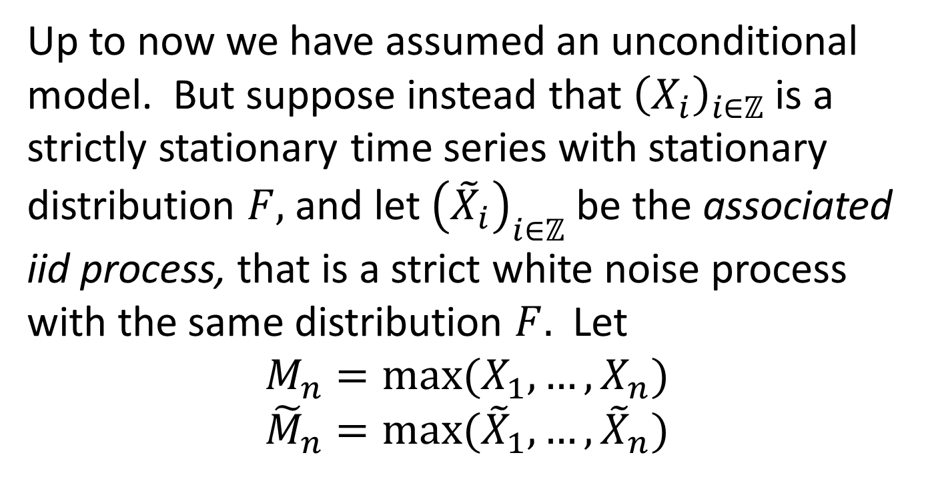
Maxima of Time Series
Up to now we have assumed an unconditional model. But suppose instead that ${\left(X_{i}\right)}_{i∈ℤ}$ is a strictly stationary time series with stationary distribution $F,$ and let ${\left({\tilde{X}}_{i}\right)}_{i∈ℤ}$ be the associated iid process, that is a strict white noise process with the same distribution $F.$ Let
$$M_{n}=max⁡(X_{1},…,X_{n})$$
$${\tilde{M}}_{n}=max⁡({\tilde{X}}_{1},…,{\tilde{X}}_{n})$$

Slide 15
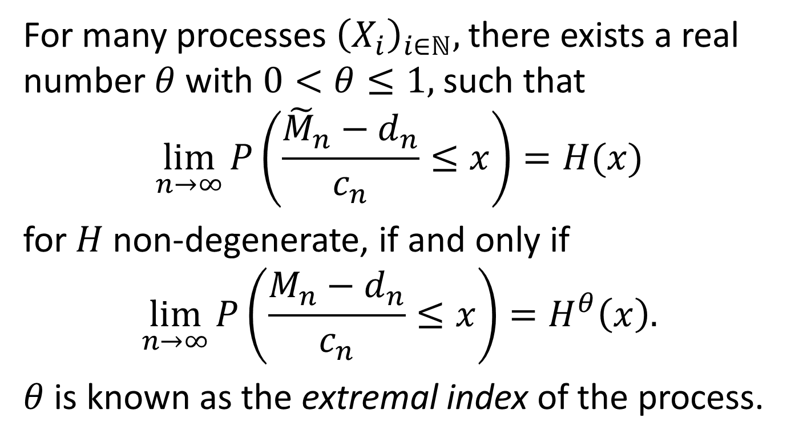
Maxima of Time Series, Cont’d
For many processes ${\left(X_{i}\right)}_{i∈ℕ},$there exists a real number $θ$ with $0<θ≤1,$ such that
$$\lim_{n→∞}{P\left(\frac{{\tilde{M}}_{n}−d_{n}}{c_{n}}≤x\right)}=H(x)$$
for $H$ non-degenerate, if and only if
$$\lim_{n→∞}{P\left(\frac{M_{n}−d_{n}}{c_{n}}≤x\right)}=H^{θ}\left(x\right).$$
$θ$ is known as the extremal index of the process.

Slide 16
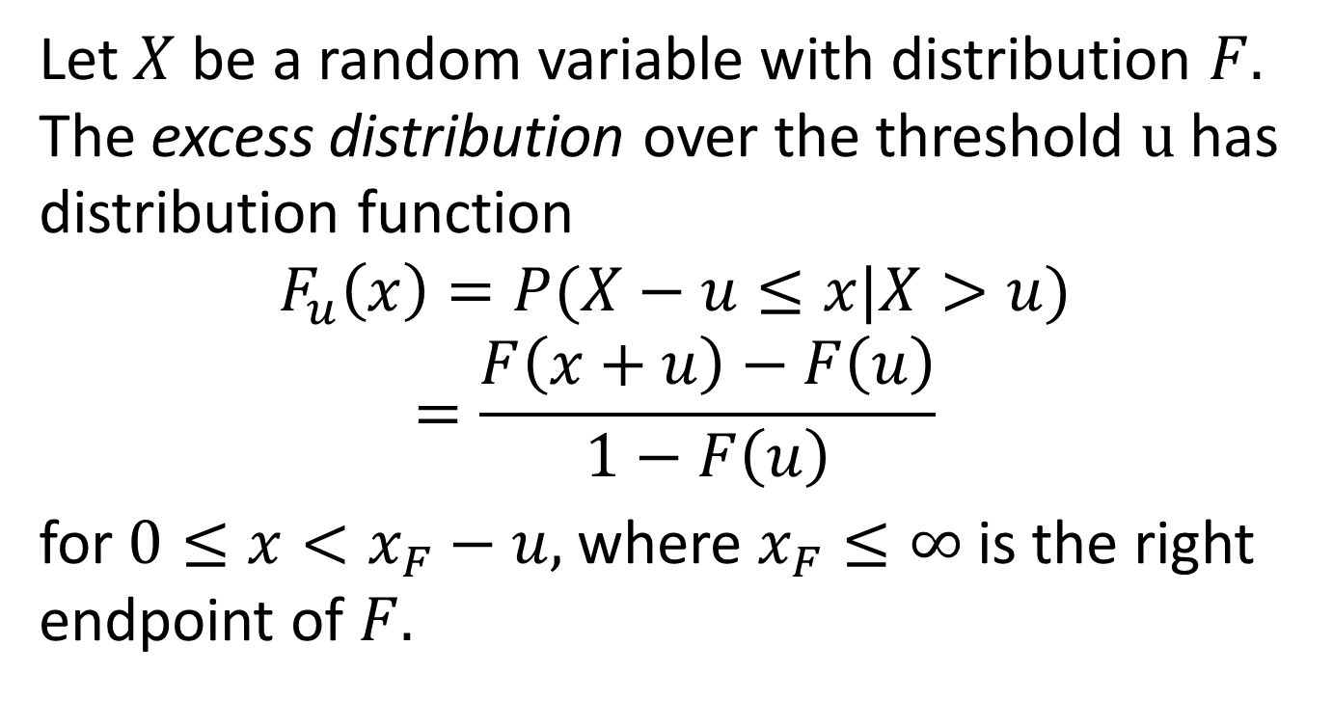
Threshold Exceedences
Let $X$ be a random variable with distribution $F.$ The excess distribution over the threshold $u$has distribution function
$$F_{u}\left(x\right)=P(X−u≤x|X>u)$$
$$=\frac{F\left(x+u\right)−F\left(u\right)}{1−F\left(u\right)}$$
for $0≤x<x_{F}−u,$ where $x_{F}≤∞$ is the right endpoint of $F.$

Slide 17
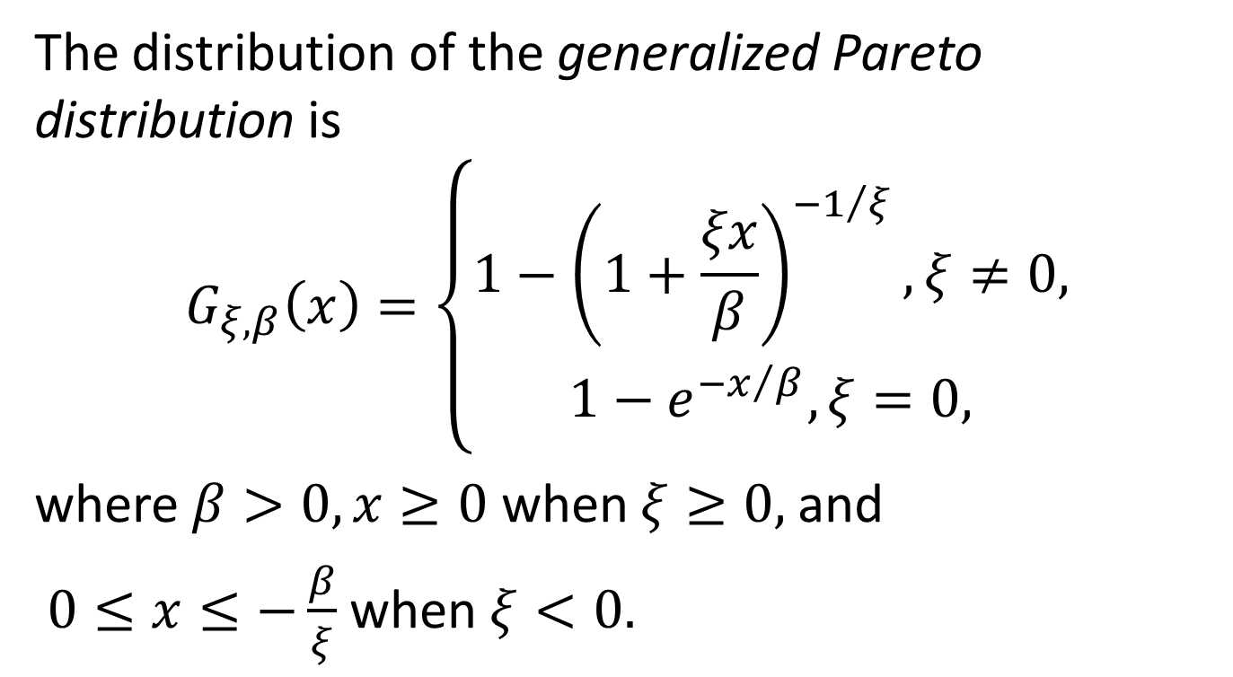
Generalized Pareto Distribution
The distribution of the generalized Pareto distribution is
$$G_{ξ,β}\left(x\right)=\left\{\begin{matrix}1−{\left(1+\frac{ξx}{β}\right)}^{−1/ξ},ξ≠0, \\ 1−e^{−x/β},ξ=0,\end{matrix}\right.$$
where $β>0,x≥0$ when $ξ≥0,$and
$0≤x≤−\frac{β}{ξ}$ when $ξ<0.$

Slide 18
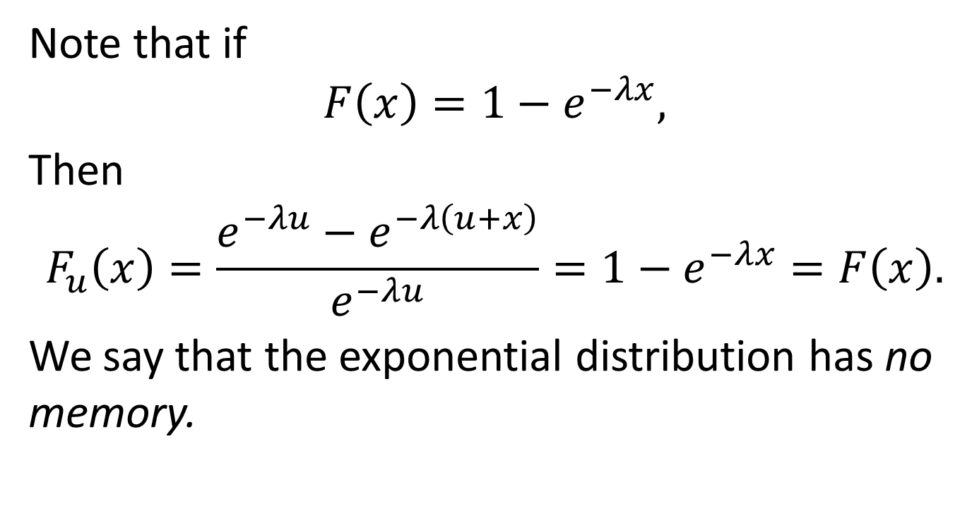
Excess Distribution for Exponential Distribution
Note that if
$$F\left(x\right)=1−e^{−λx},$$
Then
$$F_{u}\left(x\right)=\frac{e^{−λu}−e^{−λ\left(u+x\right)}}{e^{−λu}}=1−e^{−λx}=F\left(x\right).$$
We say that the exponential distribution has no memory.

Slide 19

Some Properties of GPD
$$G_{ξ,β}∈MDA\left(H_{ξ}\right), ξ∈ℝ$$
$$F=G_{ξ,β}⇒F_{u}=G_{ξ,β+ξu},$$
$$x≥0 ifξ≥0,$$
$$0≤x≤−\frac{β}{ξ}−u if ξ<0.$$
$$E\left(X\right)=\frac{β}{1−ξ} for ξ<1$$
$$e\left(u\right)=E\left(X−u | X>u\right)=\frac{β+ξu}{1−ξ}$$
$$0≤u<∞ if0≤ξ<1,$$
$$0≤u≤−\frac{β}{ξ} if ξ<0.$$

Slide 20
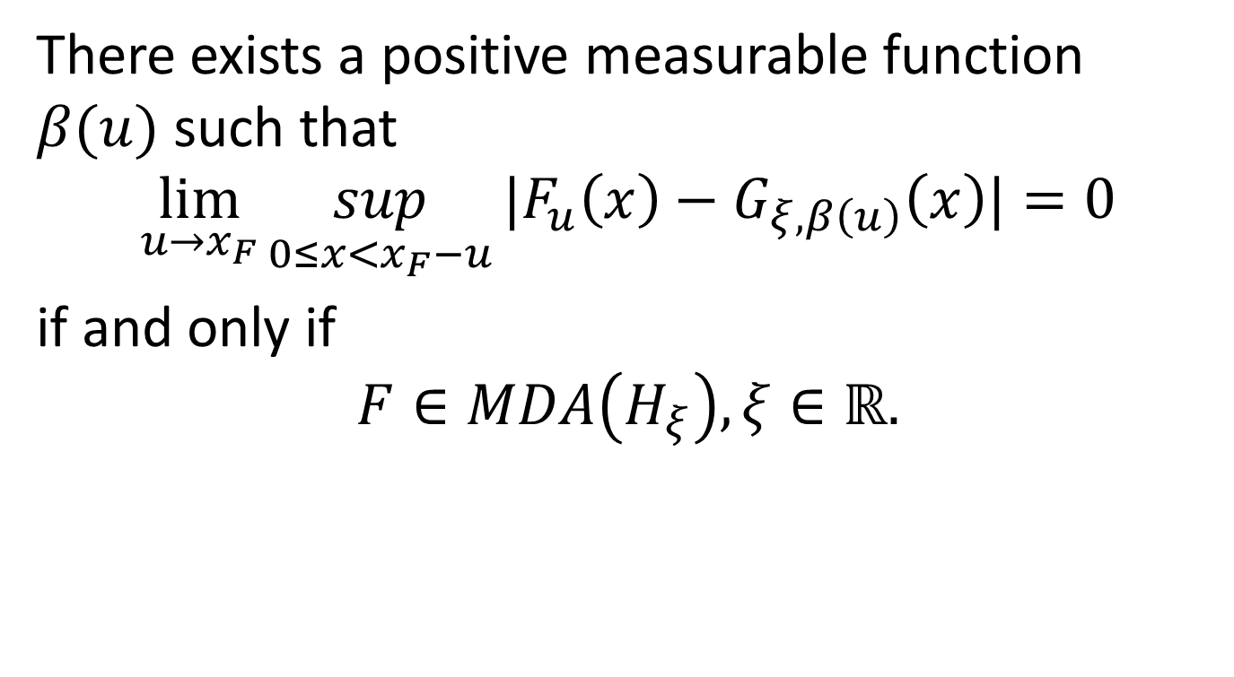
An Important Theorem
There exists a positive measurable function $β(u)$ such that
$$\lim_{u→x_{F}}{\sup_{0≤x<x_{F}−u}{|F_{u}\left(x\right)−G_{ξ,β\left(u\right)}\left(x\right)|}}=0$$
if and only if
$$F∈MDA\left(H_{ξ}\right),ξ∈ℝ.$$

Slide 21
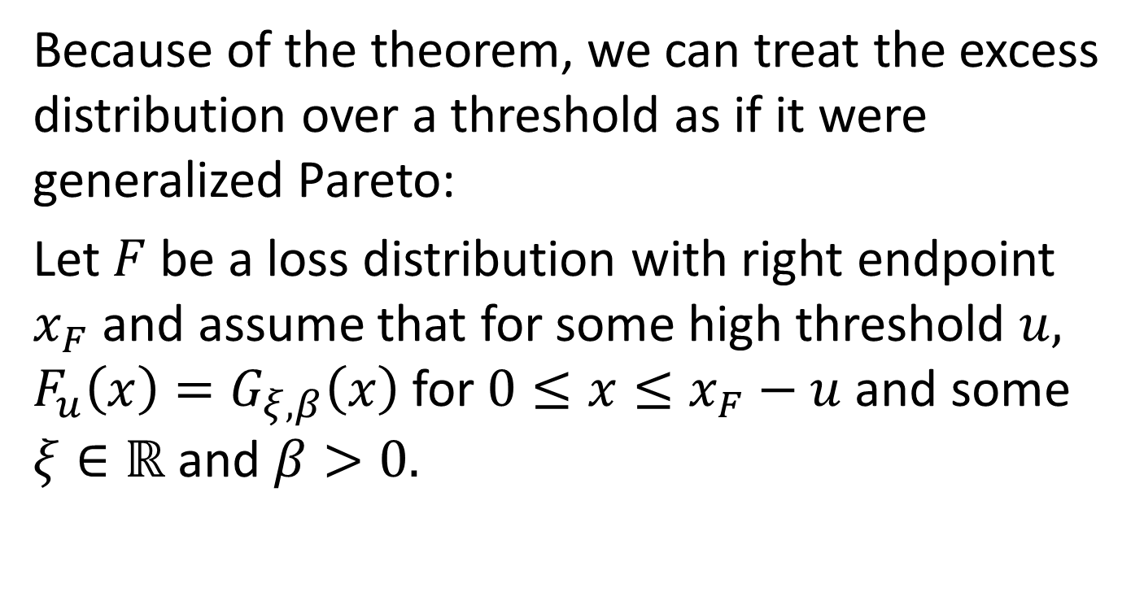
An Important Assumption
Because of the theorem, we can treat the excess distribution over a threshold as if it were generalized Pareto:
Let $F$be a loss distribution with right endpoint $x_{F}$ and assume that for some high threshold $u,$ $F_{u}\left(x\right)=G_{ξ,β}\left(x\right)$for $0≤x≤x_{F}−u$and some $ξ∈ℝ$ and $β>0.$

Slide 22
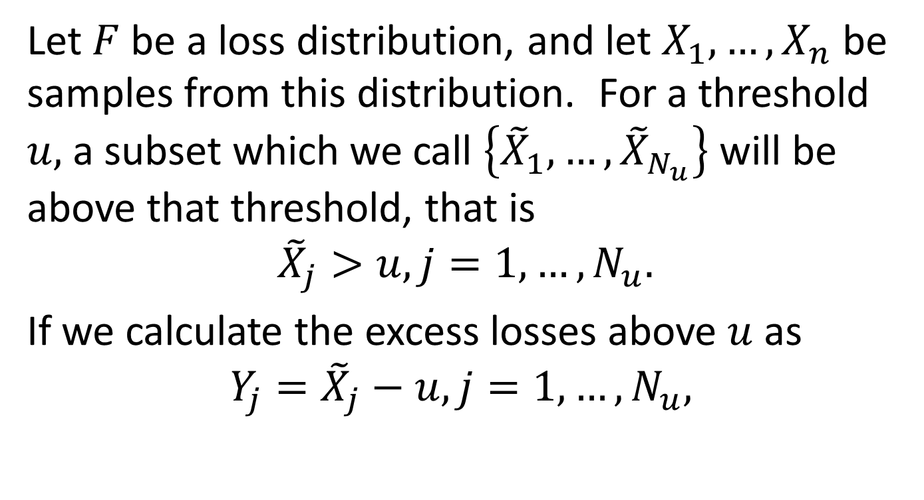
Fitting the Excess Distribution
Let $F$ be a loss distribution, and let $X_{1},…,X_{n}$ be samples from this distribution. For a threshold $u,$ a subset which we call $\left\{{\tilde{X}}_{1},…,{\tilde{X}}_{N_{u}}\right\}$ will be above that threshold, that is
$${\tilde{X}}_{j}>u, j=1,…,N_{u}.$$
If we calculate the excess losses above $u$as
$$Y_{j}={\tilde{X}}_{j}−u,j=1,…,N_{u},$$

Slide 23
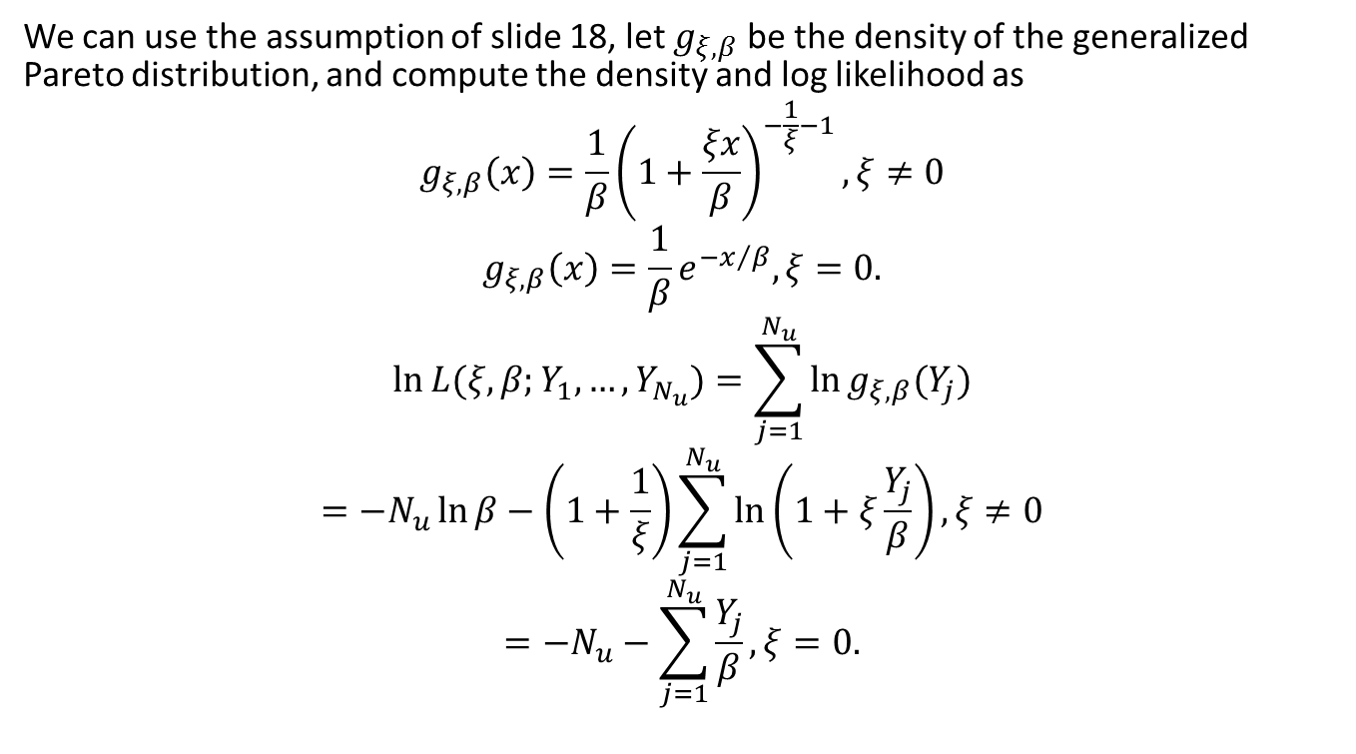
Fitting the Excess Distribution, cont’d
We can use the assumption of slide 18, let $g_{ξ,β}$ be the density of the generalized Pareto distribution, and compute the density and log likelihood as
$$g_{ξ,β}\left(x\right)=\frac{1}{β}{\left(1+\frac{ξx}{β}\right)}^{−\frac{1}{ξ}−1},ξ≠0$$
$$g_{ξ,β}\left(x\right)=\frac{1}{β}e^{−x/β},ξ=0.$$
$$\ln{L(ξ,β;Y_{1},…,Y_{N_{u}})}=\sum_{j=1}^{N_{u}}{\ln{g_{ξ,β}(Y_{j})}}$$
$$=−N_{u}\ln{β}−\left(1+\frac{1}{ξ}\right)\sum_{j=1}^{N_{u}}{\ln\left(1+ξ\frac{Y_{j}}{β}\right)},ξ≠0$$
$$=−N_{u}−\sum_{j=1}^{N_{u}}{\frac{Y_{j}}{β}}, ξ=0.$$

Slide 24
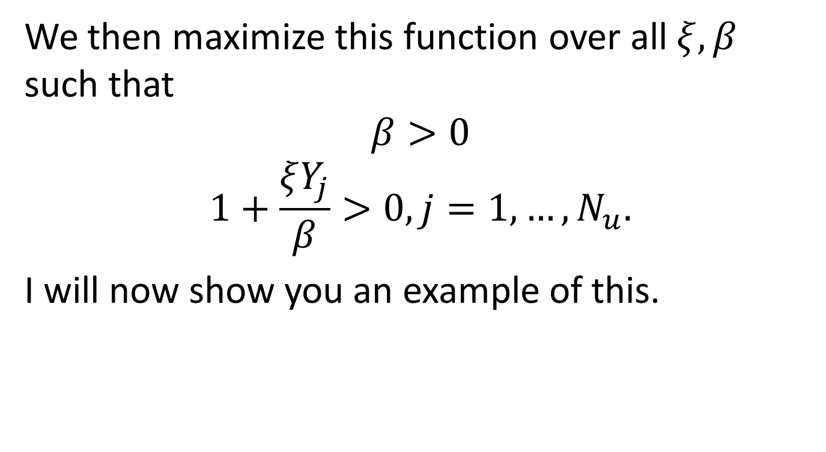
Fitting the Excess Distribution, Cont’d
We then maximize this function over all $ξ,β$ such that
$$β>0$$
$$1+\frac{ξY_{j}}{β}>0, j=1,…,N_{u}.$$
I will now show you an example of this.

Slide 25
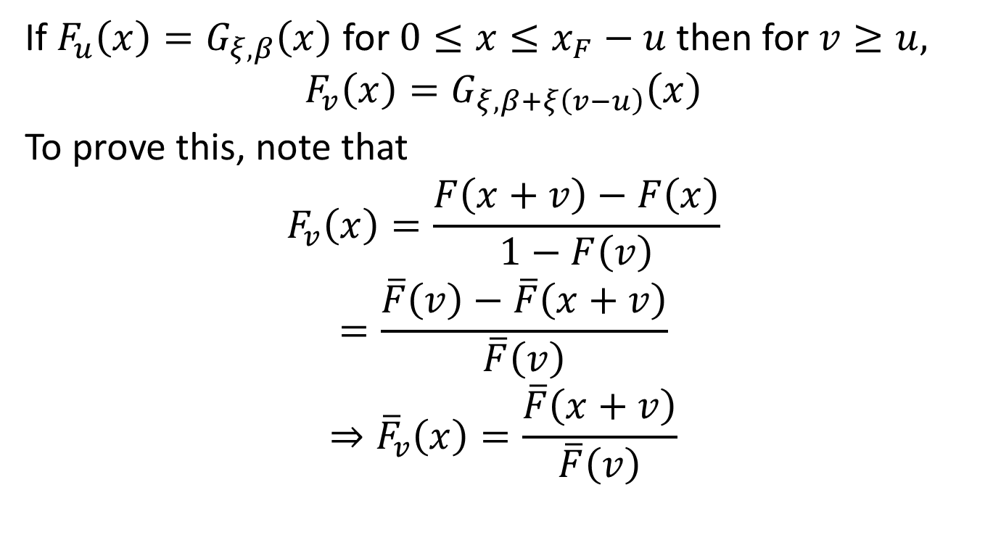
Higher Thresholds
If $F_{u}\left(x\right)=G_{ξ,β}\left(x\right)$ for $0≤x≤x_{F}−u$then for $v≥u,$
$$F_{v}\left(x\right)=G_{ξ,β+ξ\left(v−u\right)}\left(x\right)$$
To prove this, note that
$$F_{v}\left(x\right)=\frac{F\left(x+v\right)−F\left(x\right)}{1−F\left(v\right)}$$
$$=\frac{\overline{F}\left(v\right)−\overline{F}\left(x+v\right)}{\overline{F}\left(v\right)}$$
$$⇒{\overline{F}}_{v}\left(x\right)=\frac{\overline{F}\left(x+v\right)}{\overline{F}\left(v\right)}$$

Slide 26
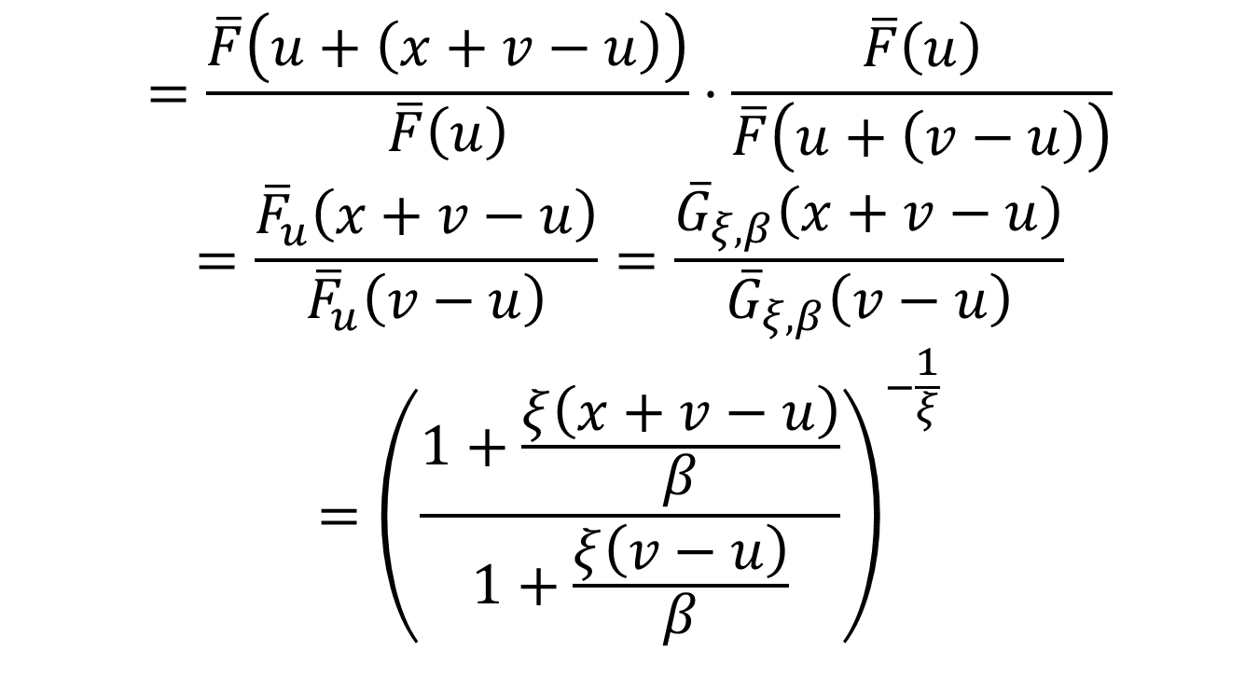
Higher Thresholds, cont’d
$$=\frac{\overline{F}\left(u+\left(x+v−u\right)\right)}{\overline{F}\left(u\right)}⋅\frac{\overline{F}\left(u\right)}{\overline{F}\left(u+\left(v−u\right)\right)}$$
$$=\frac{{\overline{F}}_{u}\left(x+v−u\right)}{{\overline{F}}_{u}\left(v−u\right)}=\frac{{\overline{G}}_{ξ,β}\left(x+v−u\right)}{{\overline{G}}_{ξ,β}\left(v−u\right)}$$
$$={\left(\frac{1+\frac{ξ\left(x+v−u\right)}{β}}{1+\frac{ξ\left(v−u\right)}{β}}\right)}^{−\frac{1}{ξ}}$$

Slide 27
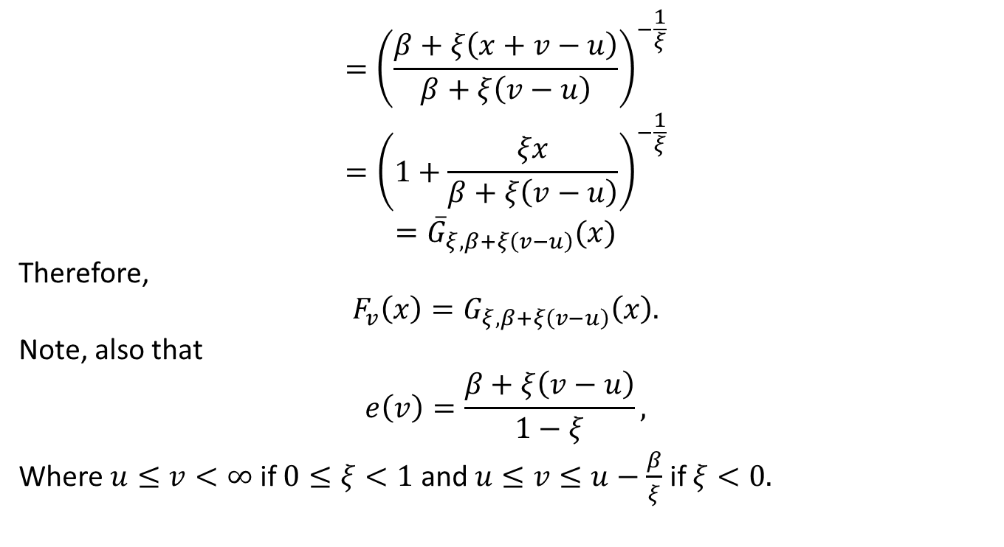
Higher Thresholds, cont’d
$$={\left(\frac{β+ξ\left(x+v−u\right)}{β+ξ\left(v−u\right)}\right)}^{−\frac{1}{ξ}}$$
$$={\left(1+\frac{ξx}{β+ξ\left(v−u\right)}\right)}^{−\frac{1}{ξ}}$$
$$={\overline{G}}_{ξ,β+ξ\left(v−u\right)}(x)$$
Therefore,
$$F_{v}\left(x\right)=G_{ξ,β+ξ\left(v−u\right)}\left(x\right).$$
Note, also that
$$e\left(v\right)=\frac{β+ξ\left(v−u\right)}{1−ξ},$$
Where $u≤v<∞$ if $0≤ξ<1$ and $u≤v≤u−\frac{β}{ξ}$ if $ξ<0.$

Slide 28
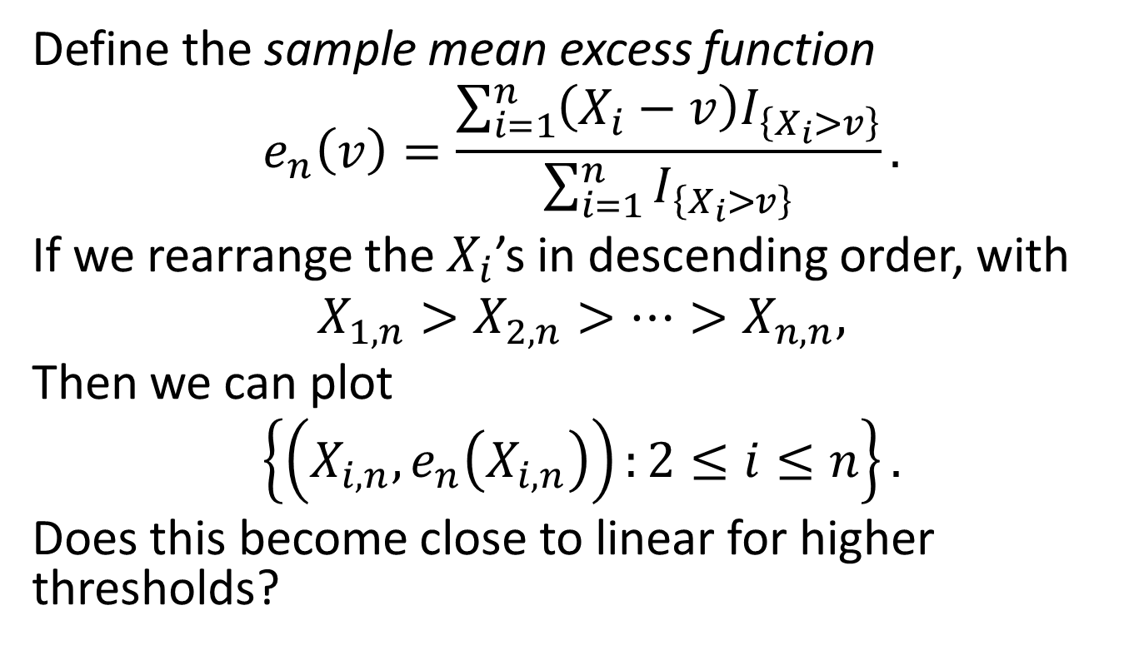
Sample Mean Excess Plot
Define the sample mean excess function
$$e_{n}\left(v\right)=\frac{\sum_{i=1}^{n}{\left(X_{i}−v\right)I_{\left\{X_{i}>v\right\}}}}{\sum_{i=1}^{n}{I_{\left\{X_{i}>v\right\}}}}.$$
If we rearrange the $X_{i}$’s in descending order, with
$$X_{1,n}>X_{2,n}>…>X_{n,n},$$
Then we can plot
$$\left\{\left(X_{i,n},e_{n}\left(X_{i,n}\right)\right):2≤i≤n\right\}.$$
Does this become close to linear for higher thresholds?

Slide 29
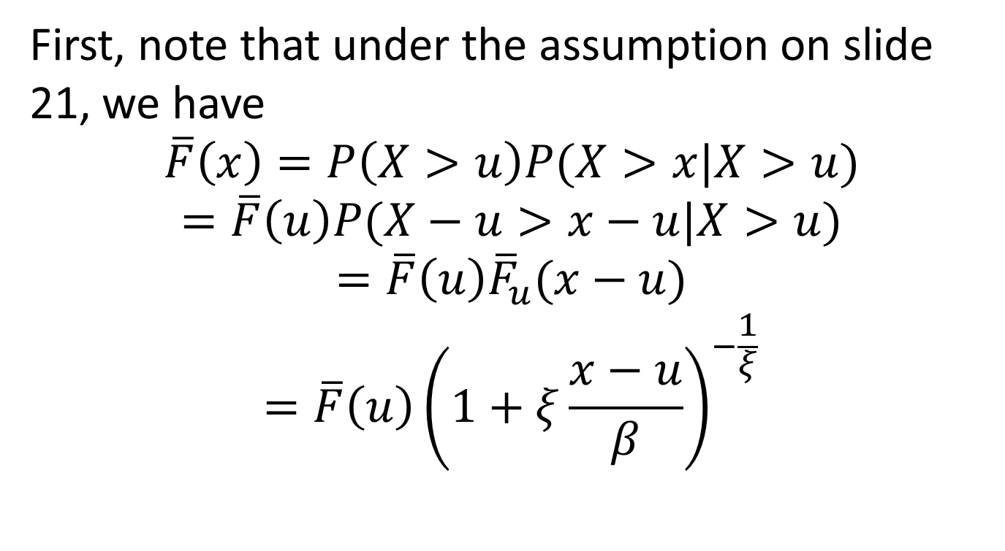
VaR and ES
First, note that under the assumption on slide 21, we have
$$\overline{F}\left(x\right)=P\left(X>u\right)P(X>x|X>u)$$
$$=\overline{F}\left(u\right)P(X−u>x−u|X>u)$$
$$=\overline{F}\left(u\right){\overline{F}}_{u}(x−u)$$
$$=\overline{F}\left(u\right){\left(1+ξ\frac{x−u}{β}\right)}^{−\frac{1}{ξ}}$$

Slide 30
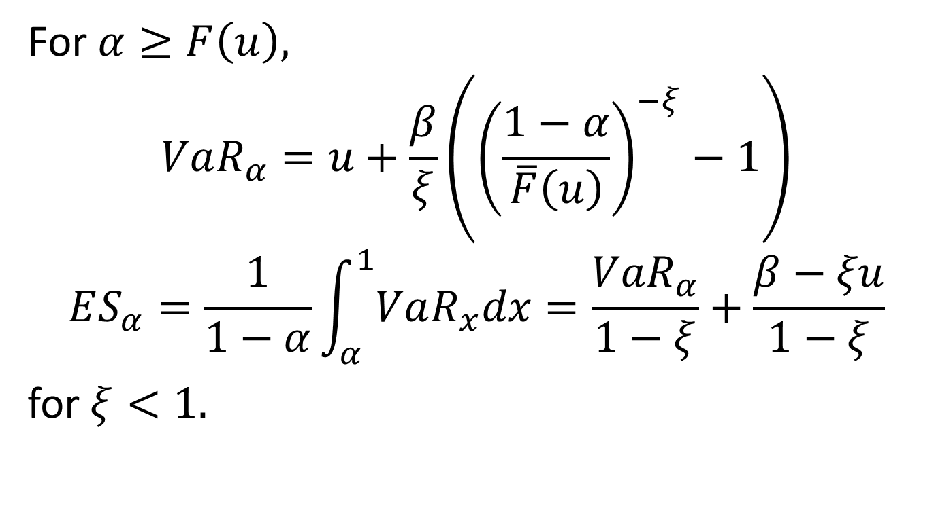
VaR and ES, cont’d
For $α≥F\left(u\right),$
$$VaR_{α}=u+\frac{β}{ξ}\left({\left(\frac{1−α}{\overline{F}\left(u\right)}\right)}^{−ξ}−1\right)$$
$$ES_{α}=\frac{1}{1−α}\int_{α}^{1}{VaR_{x}dx}=\frac{VaR_{α}}{1−ξ}+\frac{β−ξu}{1−ξ}$$
for $ξ<1.$

Slide 31
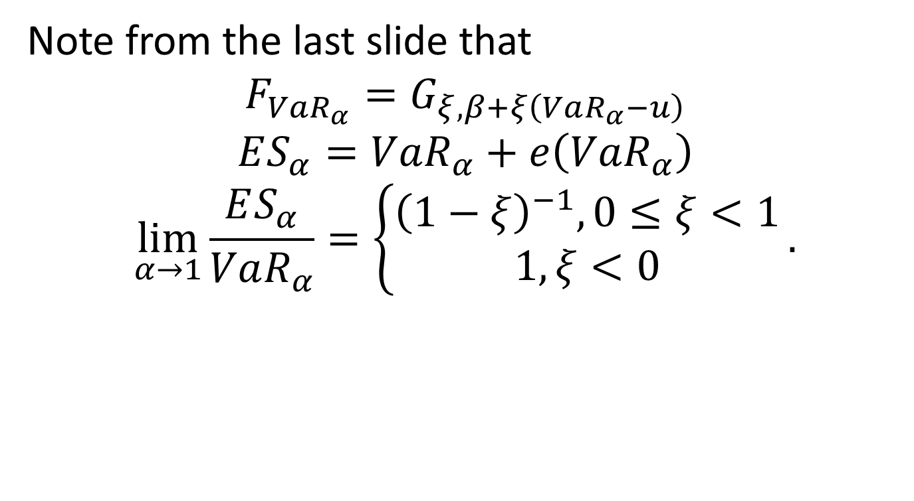
VaR and ES, cont’d
Note from the last slide that
$$F_{VaR_{α}}=G_{ξ,β+ξ\left(VaR_{α}−u\right)}$$
$$ES_{α}=VaR_{α}+e\left(VaR_{α}\right)$$
$$\lim_{α→1}{\frac{ES_{α}}{VaR_{α}}}=\left\{\begin{matrix}{\left(1−ξ\right)}^{−1}, 0≤ξ<1 \\ 1, ξ<0\end{matrix}\right..$$

Slide 32
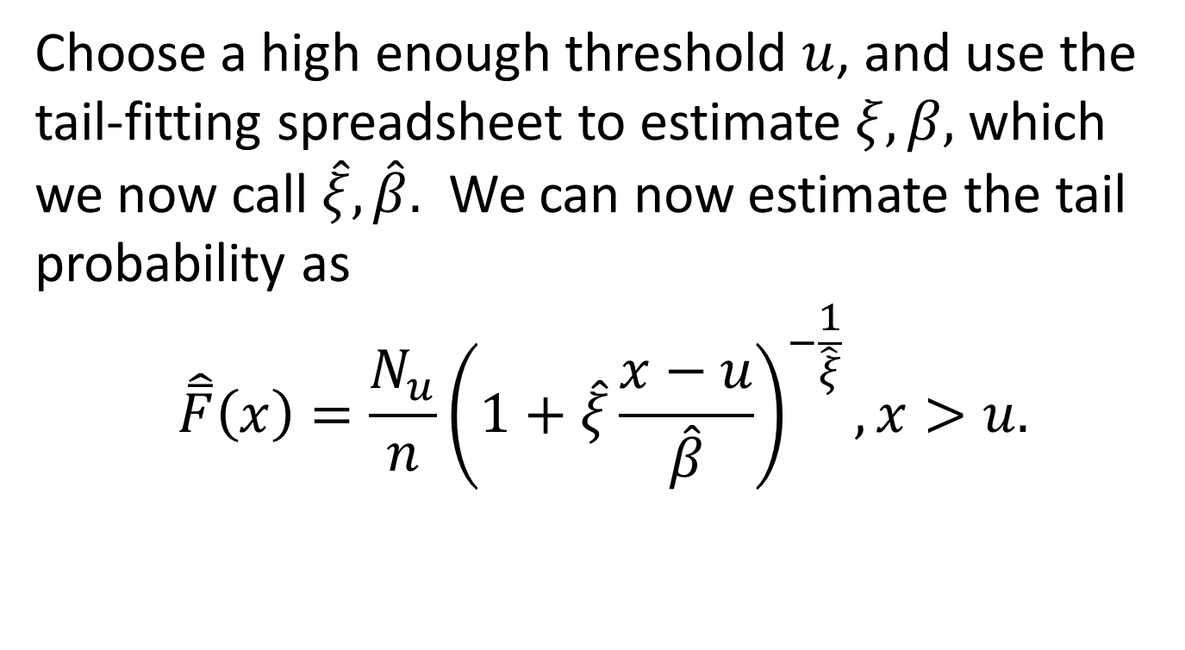
An Estimate of Tail Probability
Choose a high enough threshold $u$, and use the tail-fitting spreadsheet to estimate $ξ,β,$ which we now call $\hat{ξ},\hat{β}.$ We can now estimate the tail probability as
$$\hat{\overline{F}}\left(x\right)=\frac{N_{u}}{n}{\left(1+\hat{ξ}\frac{x−u}{\hat{β}}\right)}^{−\frac{1}{\hat{ξ}}}, x>u.$$

Slide 33
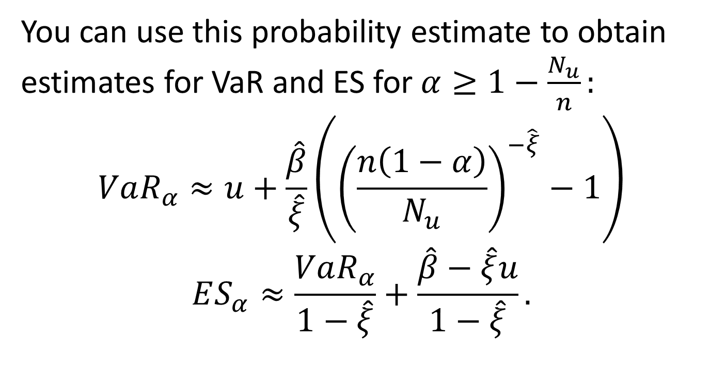
Estimating VaR, ES
You can use this probability estimate to obtain estimates for VaR and ES for $α≥1−\frac{N_{u}}{n}:$
$$VaR_{α}≈u+\frac{\hat{β}}{\hat{ξ}}\left({\left(\frac{n\left(1−α\right)}{N_{u}}\right)}^{−\hat{ξ}}−1\right)$$
$$ES_{α}≈\frac{VaR_{α}}{1−\hat{ξ}}+\frac{\hat{β}−\hat{ξ}u}{1−\hat{ξ}}.$$

Slide 34
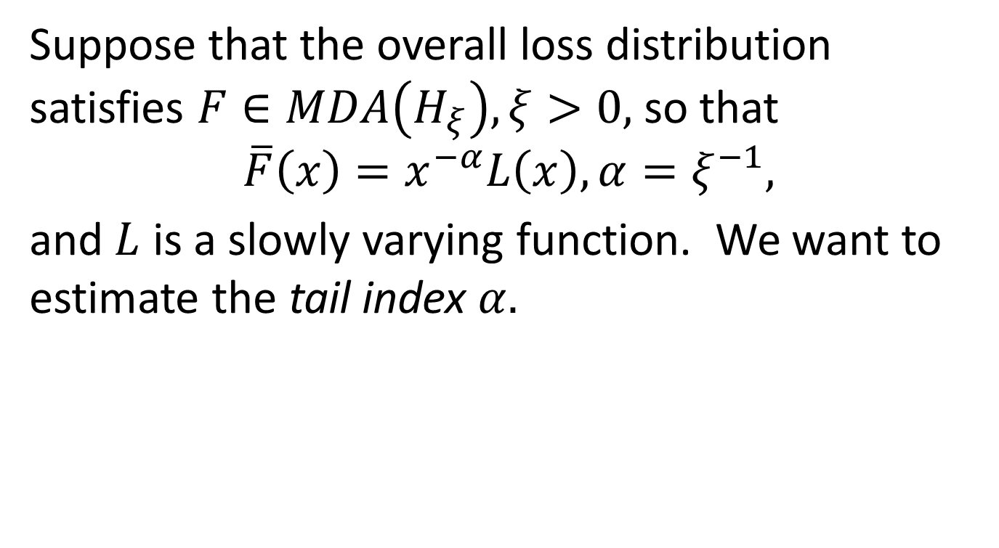
The Hill Method
Suppose that the overall loss distribution satisfies $F∈MDA\left(H_{ξ}\right),ξ>0,$so that
$$\overline{F}\left(x\right)=x^{−α}L\left(x\right), α=ξ^{−1},$$
and $L$ is a slowly varying function. We want to estimate the tail index $α.$

Slide 35
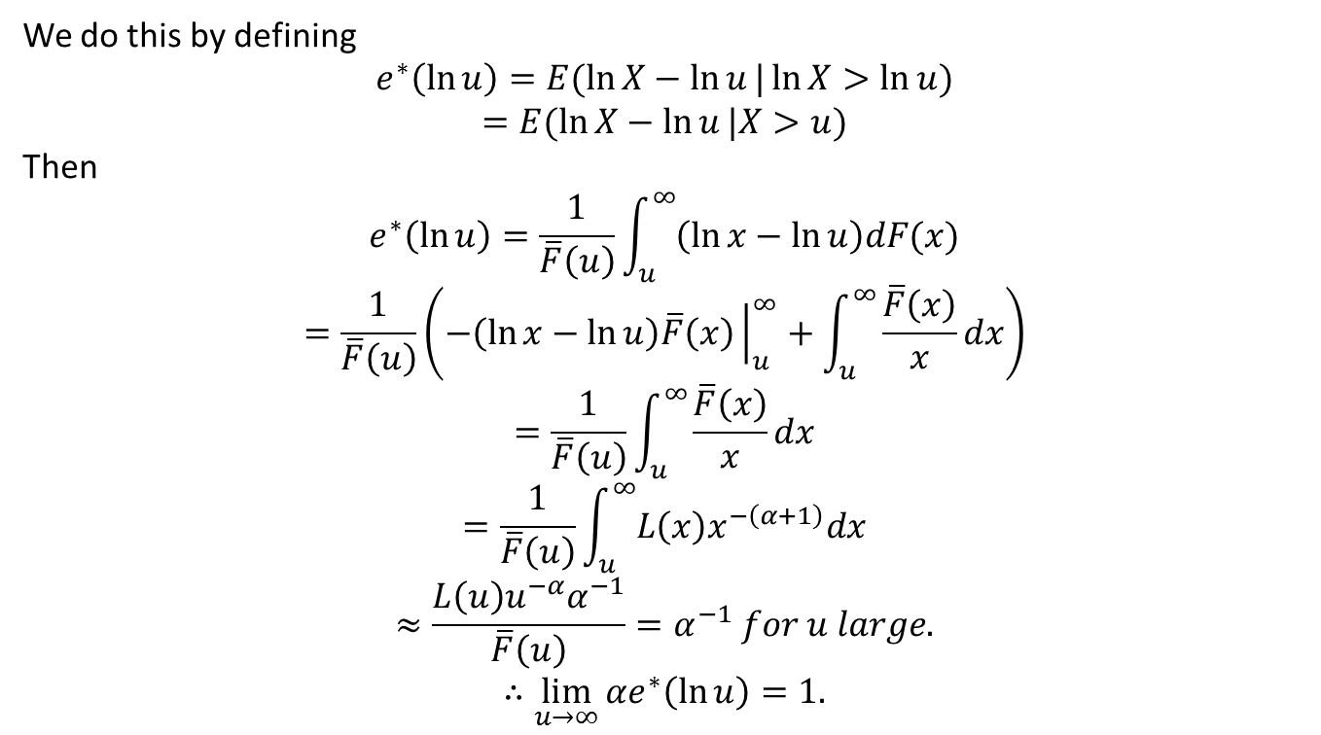
The Hill Method, cont’d
We do this by defining
$$e^{∗}\left(\ln{u}\right)=E(\ln{X}−\ln{u}|\ln{X}>\ln{u})$$
$$=E(\ln{X}−\ln{u}|X>u)$$
Then
$$e^{∗}\left(\ln{u}\right)=\frac{1}{\overline{F}\left(u\right)}\int_{u}^{∞}{\left(\ln{x}−\ln{u}\right)dF(x)}$$
$$=\frac{1}{\overline{F}\left(u\right)}\left(−\left(\ln{x}−\ln{u}\right)\overline{F}\left(x\right){\left.​\right|}_{u}^{∞}+\int_{u}^{∞}{\frac{\overline{F}\left(x\right)}{x}dx}\right)$$
$$=\frac{1}{\overline{F}\left(u\right)}\int_{u}^{∞}{\frac{\overline{F}\left(x\right)}{x}dx}$$
$$=\frac{1}{\overline{F}\left(u\right)}\int_{u}^{∞}{L\left(x\right)x^{−\left(α+1\right)}dx}$$
$$≈\frac{L\left(u\right)u^{−α}α^{−1}}{\overline{F}\left(u\right)}=α^{−1} for u large.$$
$$∴\lim_{u→∞}{αe^{∗}\left(\ln{u}\right)=1.}$$

Slide 36
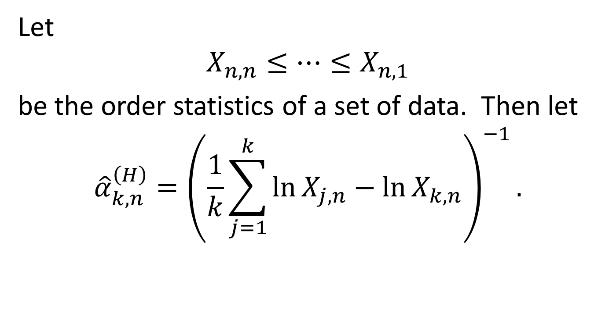
Hill Estimator
Let
$$X_{n,n}≤…≤X_{n,1}$$
be the order statistics of a set of data. Then let
$${\hat{α}}_{k,n}^{\left(H\right)}={\left(\frac{1}{k}\sum_{j=1}^{k}{\ln{X_{j,n}}}−\ln{X_{k,n}}\right)}^{−1}.$$

Slide 37

Hill Tail Estimator
$$\hat{\overline{F}}\left(x\right)=\frac{k}{n}{\left(\frac{x}{X_{k,n}}\right)}^{−{\hat{α}}_{k,n}^{\left(H\right)}},x≥X_{k,n}.$$

Slide 38
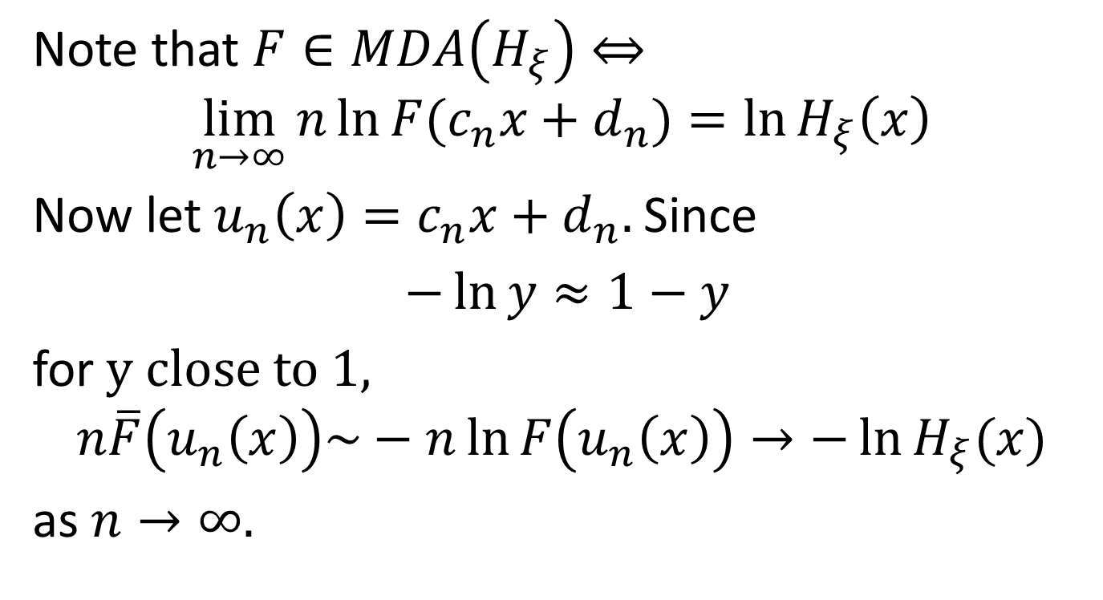
Distribution of Exceedances as Poisson
Note that $F∈MDA\left(H_{ξ}\right)⇔$
$$\lim_{n→∞}{n\ln{F(c_{n}x+d_{n})}}=\ln{H_{ξ}\left(x\right)}$$
Now let $u_{n}\left(x\right)=c_{n}x+d_{n}.$Since
$−\ln{y}≈1−y$
for $y close to 1,$
$$n\overline{F}\left(u_{n}\left(x\right)\right)\sim −n\ln{F\left(u_{n}\left(x\right)\right)}→−\ln{H_{ξ}(x)}$$
as $n→∞.$

Slide 39
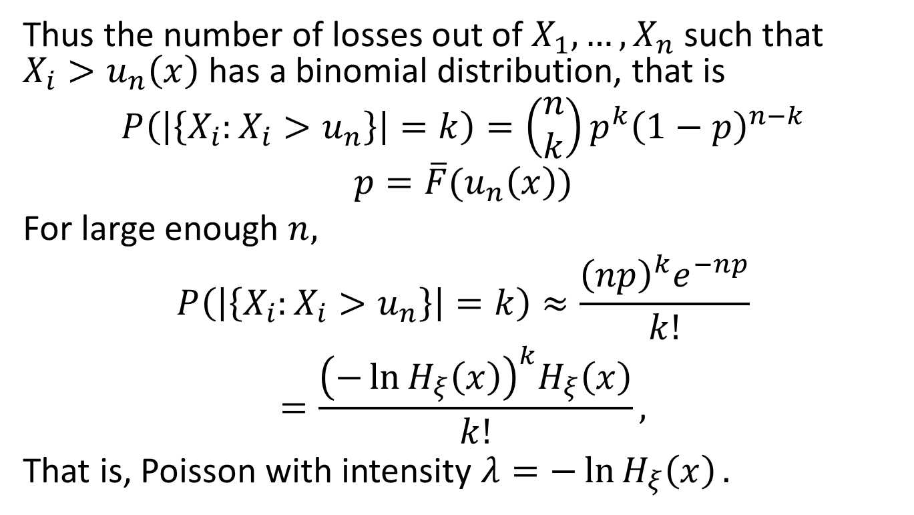
Poisson, cont’d
Thus the number of losses out of $X_{1},…,X_{n}$ such that $X_{i}>u_{n}\left(x\right)$ has a binomial distribution, that is
$$P\left(\left|\left\{X_{i}:X_{i}>u_{n}\right\}\right|=k\right)=\left(\begin{matrix}n \\ k\end{matrix}\right)p^{k}{\left(1−p\right)}^{n−k}$$
$$p=\overline{F}(u_{n}\left(x\right))$$
For large enough $n,$
$$P\left(\left|\left\{X_{i}:X_{i}>u_{n}\right\}\right|=k\right)≈\frac{{\left(np\right)}^{k}e^{−np}}{k!}$$
$$=\frac{{\left(−\ln{H_{ξ}\left(x\right)}\right)}^{k}H_{ξ}\left(x\right)}{k!},$$
That is, Poisson with intensity $λ=−\ln{H_{ξ}\left(x\right)}.$

Slide 40
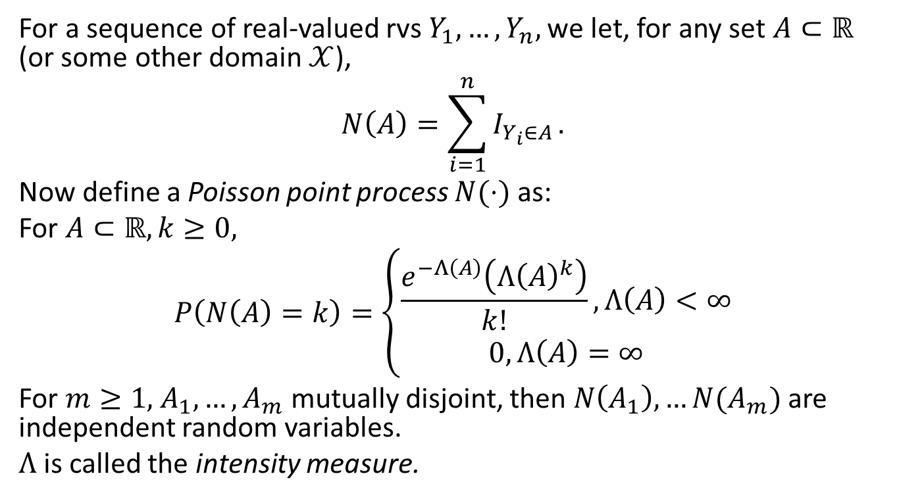
Poisson Point Process
For a sequence of real-valued rvs $Y_{1},…,Y_{n},$we let, for any set $A⊂ℝ$ (or some other domain $𝒳$),
$$N\left(A\right)=\sum_{i=1}^{n}{I_{Y_{i}∈A}}.$$
Now define a Poisson point process $N(⋅)$ as:
For $A⊂ℝ, k≥0,$
$$P\left(N\left(A\right)=k\right)=\left\{\begin{matrix}\frac{e^{−Λ\left(A\right)}\left(Λ{\left(A\right)}^{k}\right)}{k!}, Λ\left(A\right)<∞ \\ 0, Λ\left(A\right)=∞\end{matrix}\right.$$
For $m≥1,$ $A_{1},…,A_{m}$ mutually disjoint, then $N\left(A_{1}\right),…N(A_{m})$ are independent random variables.
$Λ$ is called the intensity measure.

Slide 41
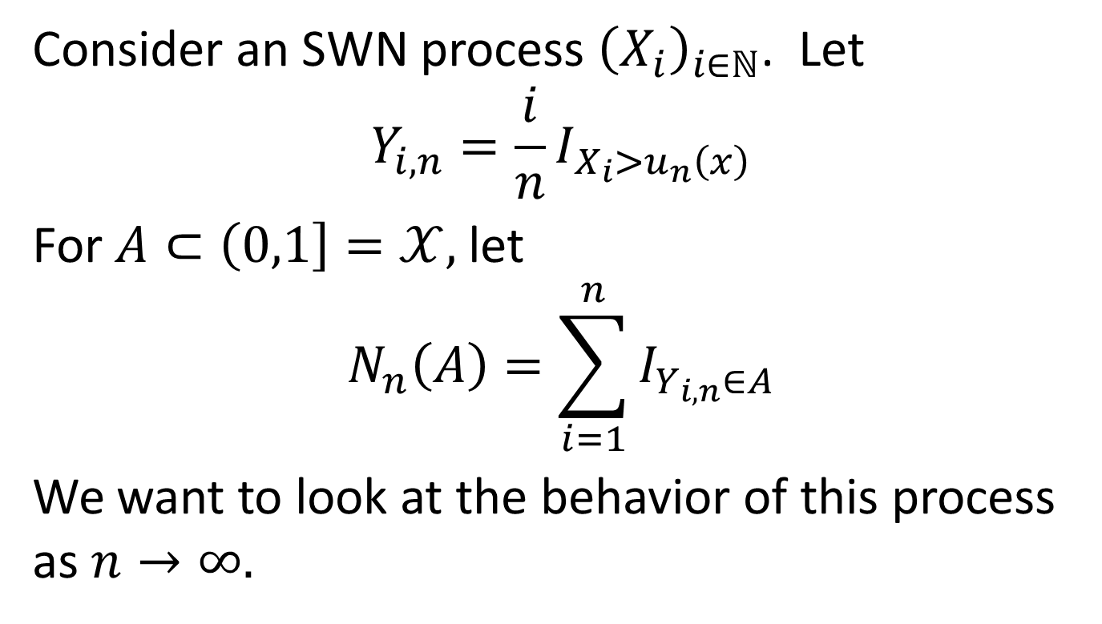
Poisson, Cont’d
Consider an SWN process ${\left(X_{i}\right)}_{i∈ℕ}$. Let
$$Y_{i,n}=\frac{i}{n}I_{X_{i}>u_{n}\left(x\right)}$$
For $A⊂\left(0,1\right]=𝒳,$ let
$$N_{n}\left(A\right)=\sum_{i=1}^{n}{I_{Y_{i,n}∈A}}$$
We want to look at the behavior of this process as $n→∞.$

Slide 42
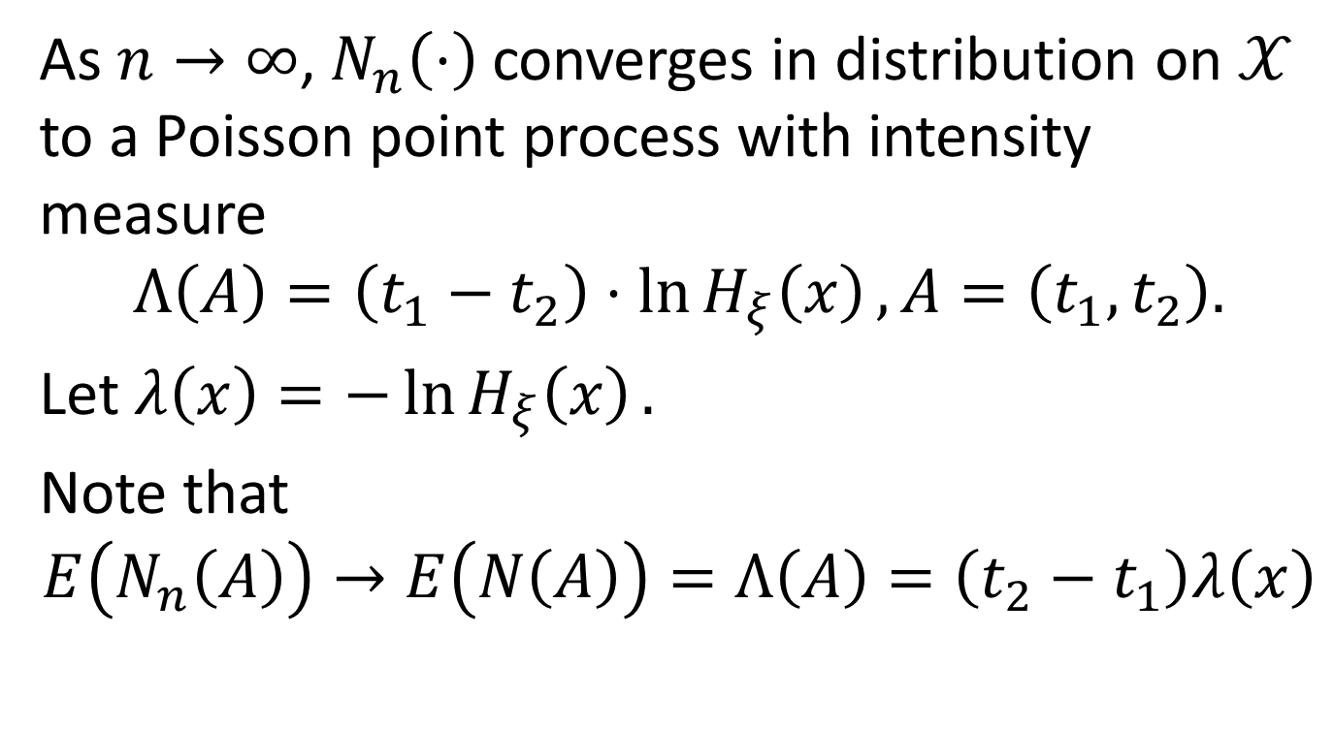
Poisson, cont’d
As $n→∞$, $N_{n}\left(⋅\right)$converges in distribution on $𝒳$ to a Poisson point process with intensity measure
$$Λ\left(A\right)=\left(t_{1}−t_{2}\right)⋅\ln{H_{ξ}\left(x\right)}, A=\left(t_{1},t_{2}\right).$$
Let $λ\left(x\right)=−\ln{H_{ξ}\left(x\right)}.$
Note that
$$E\left(N_{n}\left(A\right)\right)→E\left(N\left(A\right)\right)=Λ\left(A\right)=\left(t_{2}−t_{1}\right)λ\left(x\right)$$

Slide 43
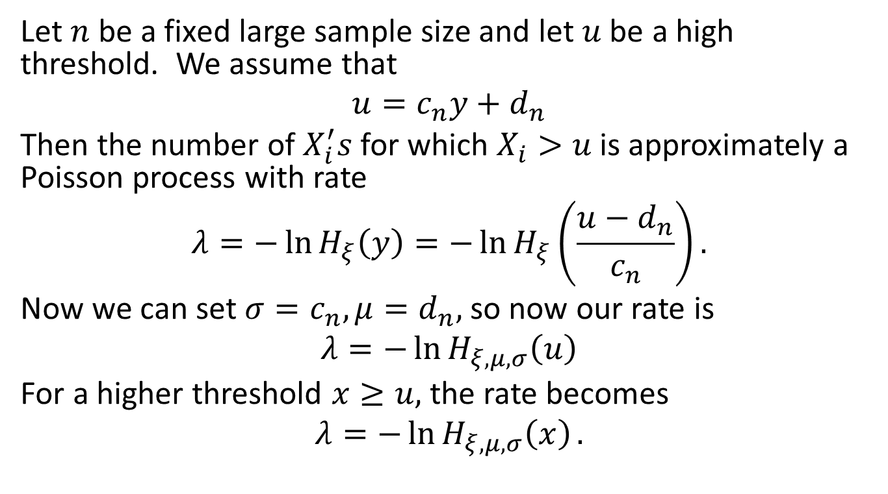
Poisson, cont’d
Let $n$ be a fixed large sample size and let $u$ be a high threshold. We assume that
$$u=c_{n}y+d_{n}$$
Then the number of $X_{i}^{′}s$for which $X_{i}>u$ is approximately a Poisson process with rate
$$λ=−\ln{H_{ξ}\left(y\right)}=−\ln{H_{ξ}\left(\frac{u−d_{n}}{c_{n}}\right)}.$$
Now we can set $σ=c_{n},μ=d_{n},$ so now our rate is
$$λ=−\ln{H_{ξ,μ,σ}\left(u\right)}$$
For a higher threshold $x≥u,$ the rate becomes
$$λ=−\ln{H_{ξ,μ,σ}\left(x\right)}.$$

